Slide 1
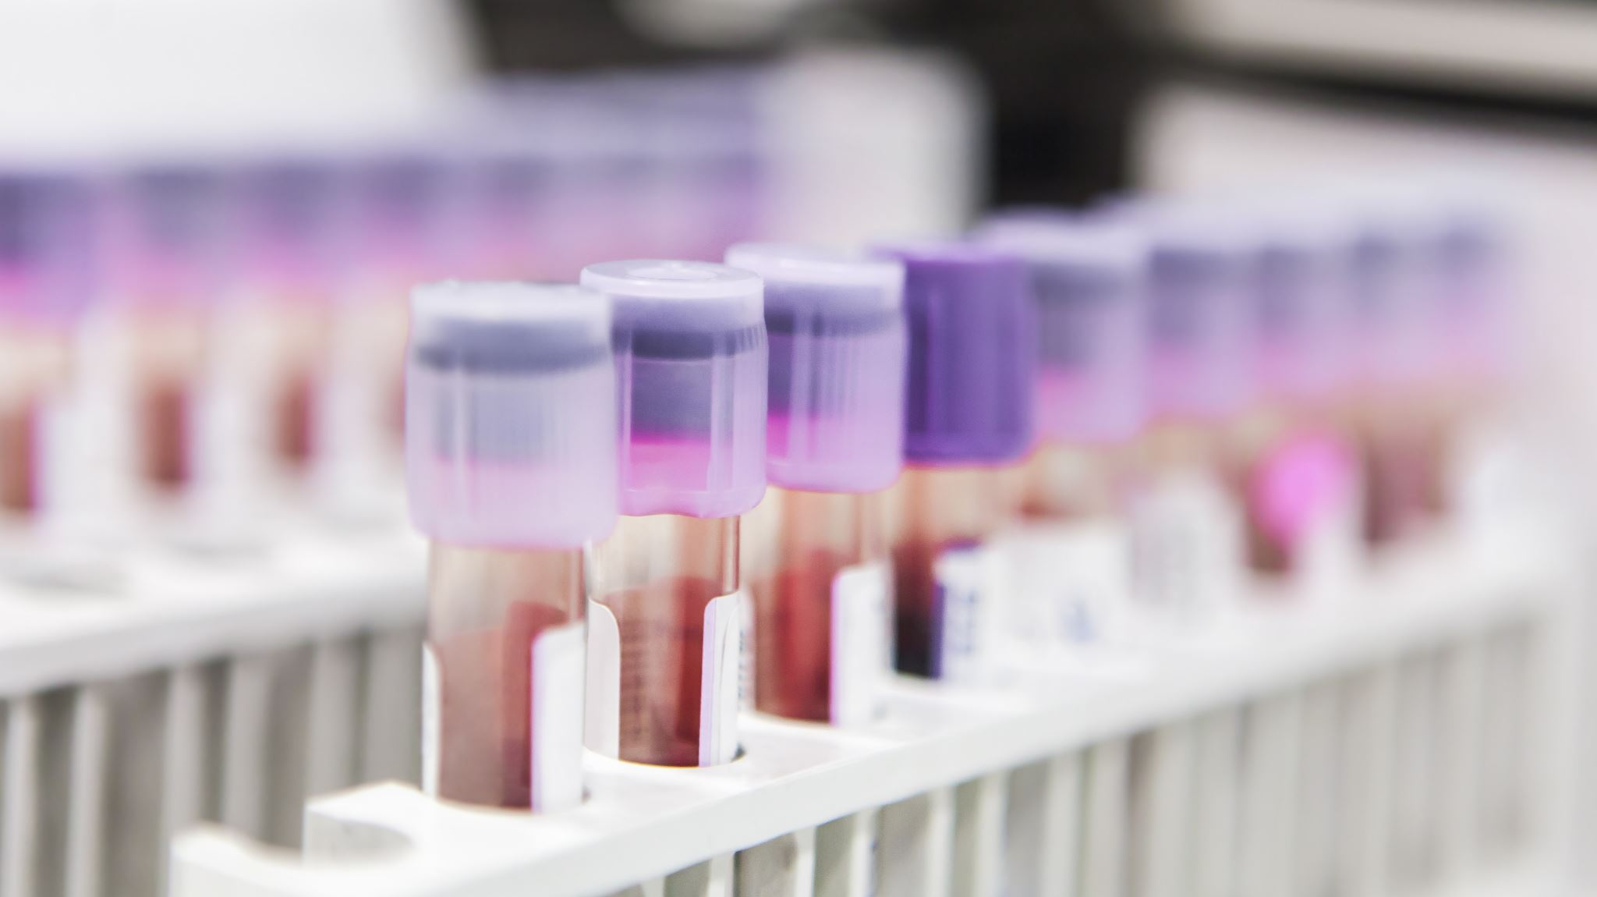

HIV Incident Rate Analysis
Nishtha Jatinbhai Patel
College of Professional Studies, Northeastern University ITC6000: Database Management Systems Professor: Venkata Duvvuri November 27, 2024

Slide 2
Content
Project Overview
Data Collection & Data Setup
Key HIV Metrics
Country Statistics
Key Performance Indicators (KPIs)
Combined Data Analysis for Bangladesh
Number of people living with HIV by country population of United States
Analysis & Summary
HIV Policy Recommendations For The Future HIV Interventions

Slide 3
Project Overview
Objective
Analyze HIV incident rates
Understand key metrics related to HIV, including prevalence, deaths, and the impact on specific demographics such as women and children.
Purpose
Provide insights into the trends of HIV rates over a decade.
Data Source
Public databases used include UNICEF, UN Data, and UNAIDS.
Assess how socio-economic factors like GDP, unemployment rate, and population influence HIV trends.
Make data-driven policy recommendations that could help improve public health interventions.
Emphasize the real-world scenario of handling unclean datasets, requiring data cleaning and transformation.
Approach
SQL was used to load, clean, and analyze data.
Created multiple tables and calculated metrics using SQL queries.
Generated trend graphs and performed combined analysis to derive key insights.
Developed key performance indicators (KPIs) to assess the impact of factors related to HIV trends.

Slide 4
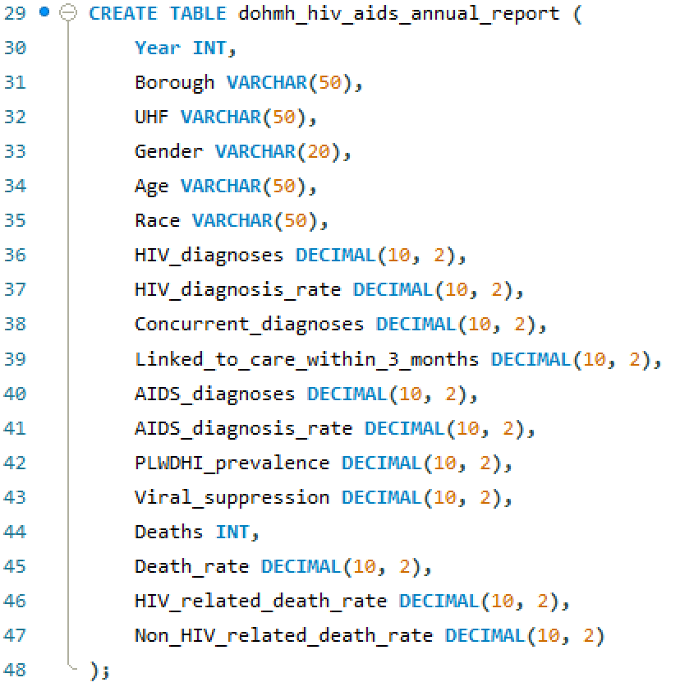
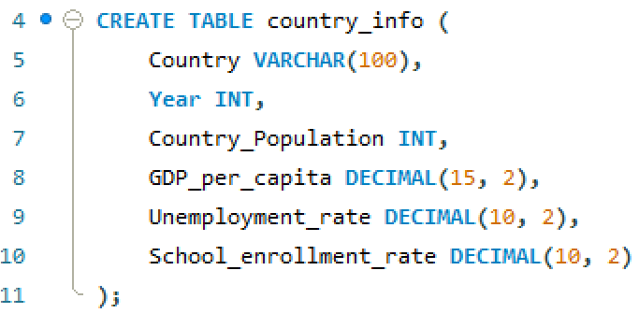
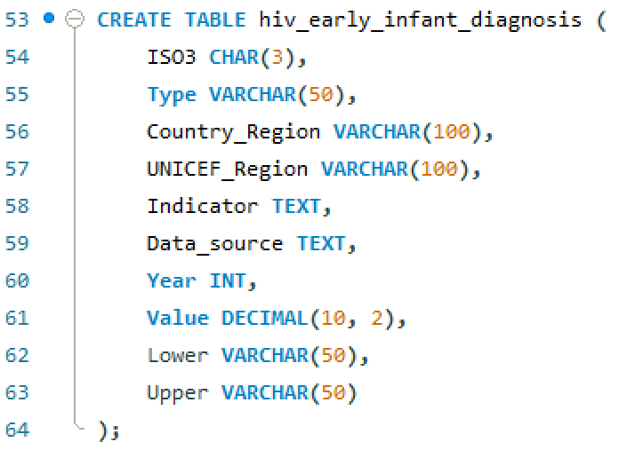
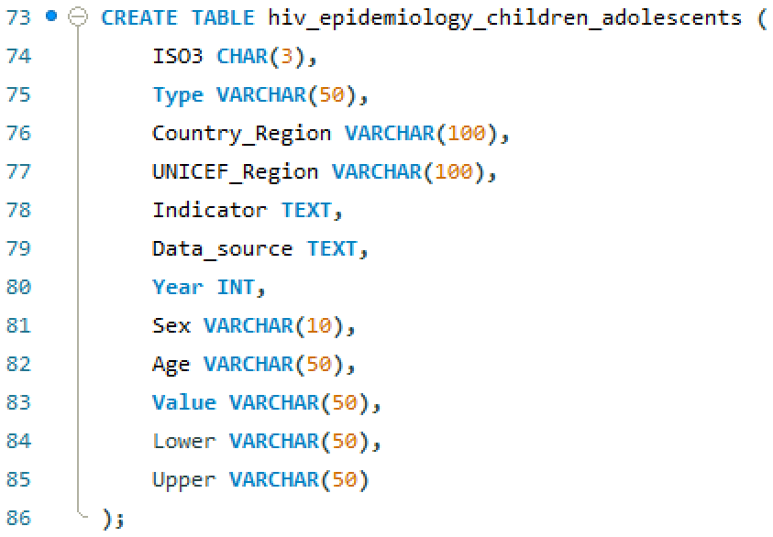
Data Collection & Database Setup

Slide 5
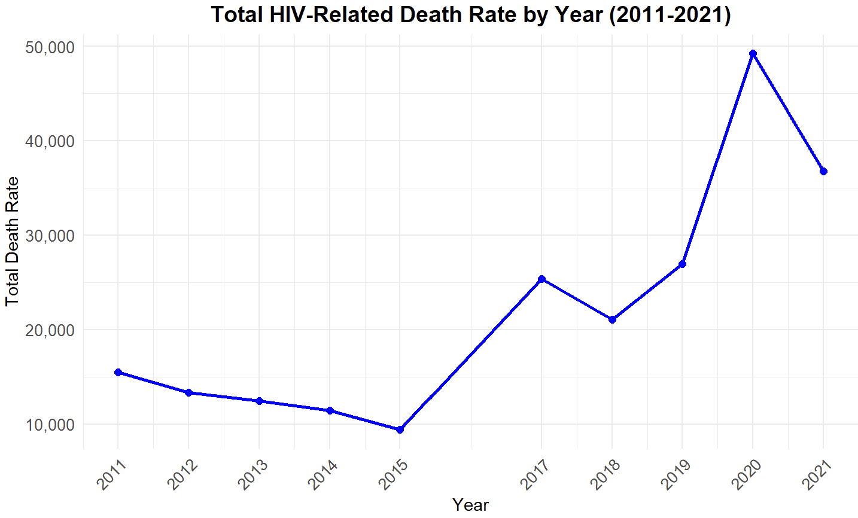
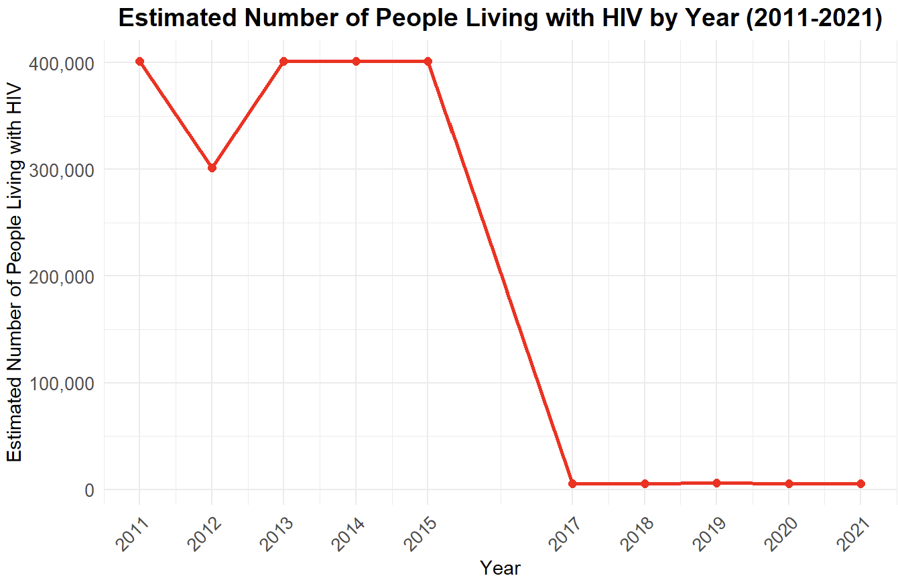
Key HIV Metrics
Estimated number of people living with HIV (by year)
Total deaths due to HIV (by year)
Sharp decline after 2015 suggests possible data reporting issues or regional changes.
Stable trends pre-2015 indicate consistent estimates during that period.
Rise in deaths post-2017, peaking in 2020, highlights potential healthcare challenges.
Decline from 2011-2015 suggests improvements in interventions or prevention strategies.

Slide 6
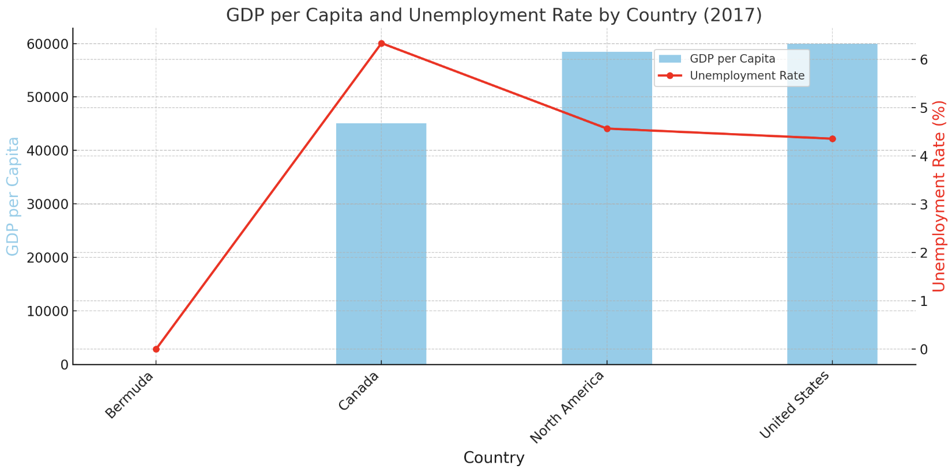
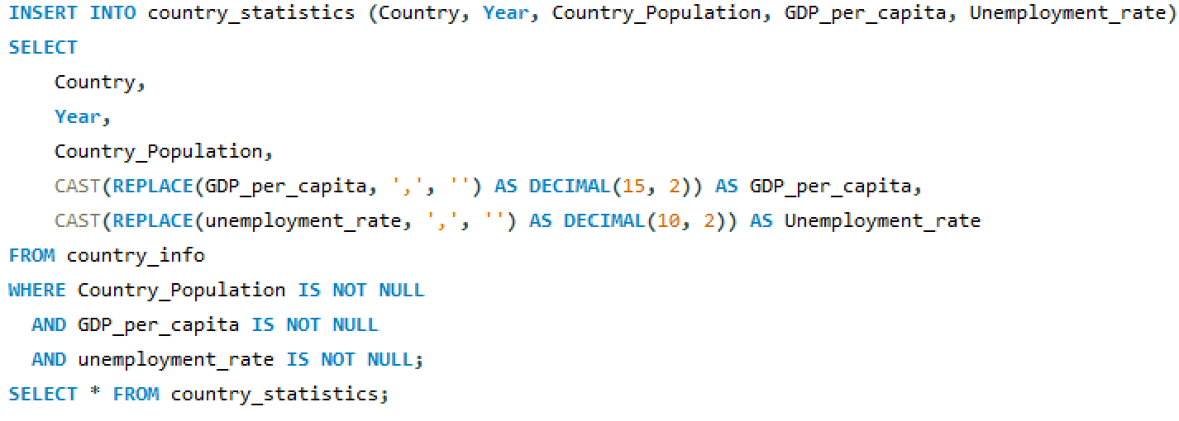
Country Statistics
Bermuda shows missing GDP per capita data for 2017 .
The United States has the highest GDP per capita and a low unemployment rate in this year.
North America as a region outperforms Canada and Bermuda in GDP per capita.

Slide 7
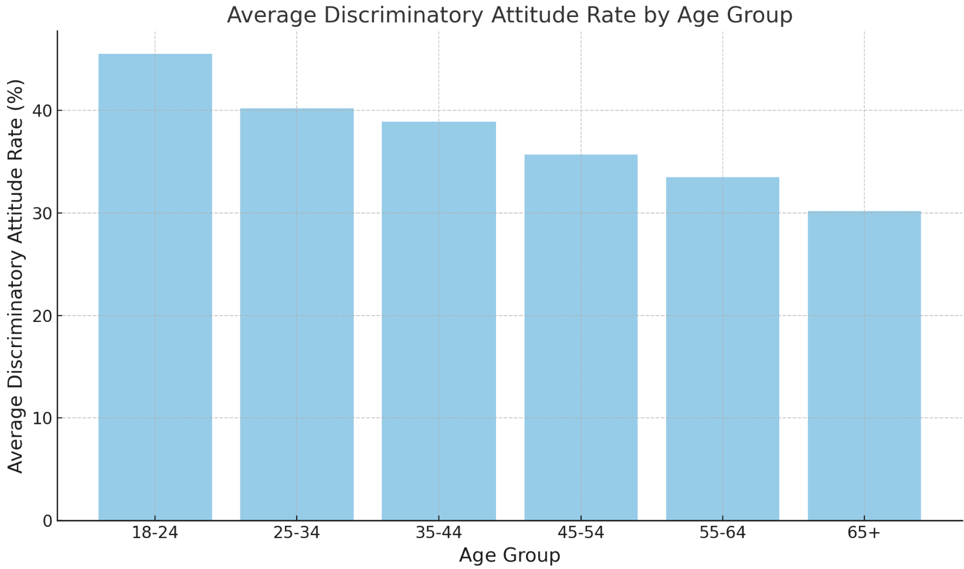
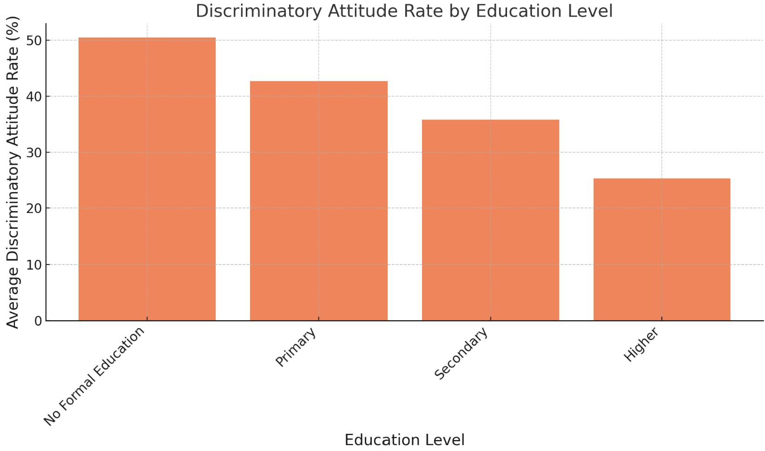
Key Performance Indicators (KPIs)
Average Discriminatory Attitude Rate by Age Group
Discriminatory Attitude Rate by Education Level
Younger age groups (18-24) show the highest discriminatory attitudes towards people living with HIV.
Discriminatory attitudes decrease consistently with increasing age, with the lowest rates in the 65+ age group.
Individuals with no formal education have the highest discriminatory attitudes.
Higher education levels are associated with significantly lower discriminatory attitudes, indicating education's role in reducing stigma.

Slide 8
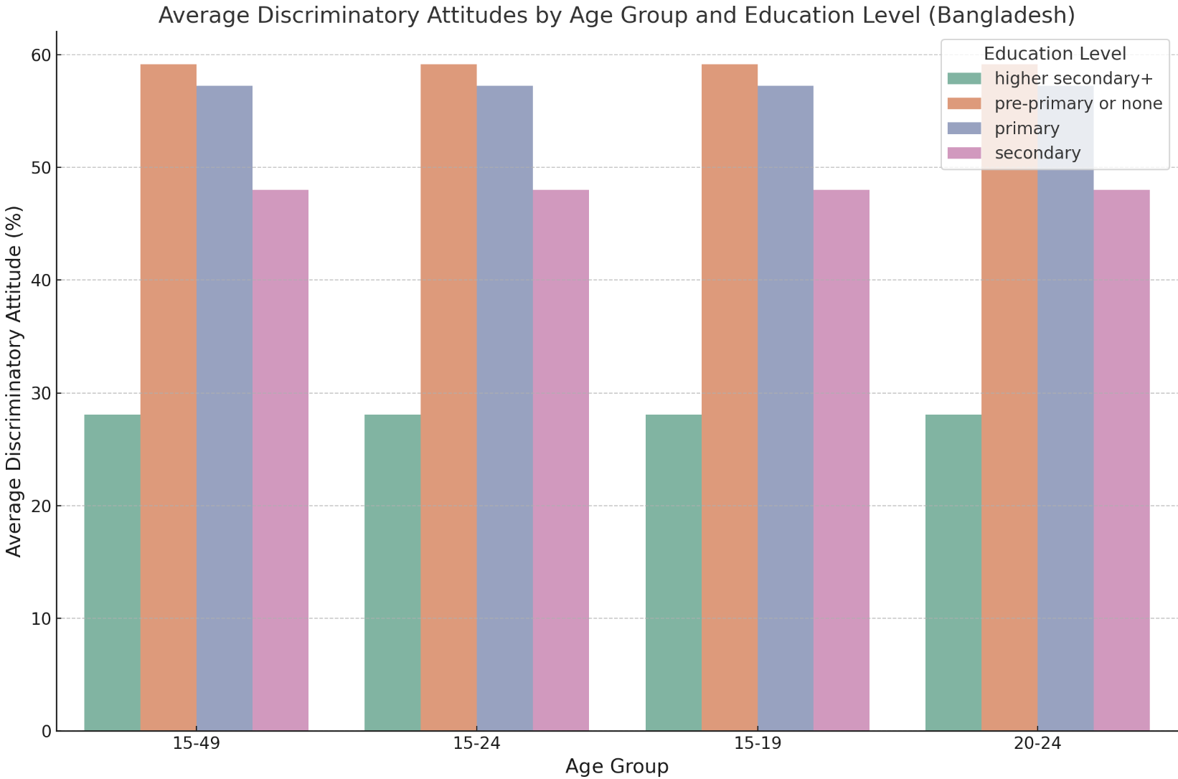
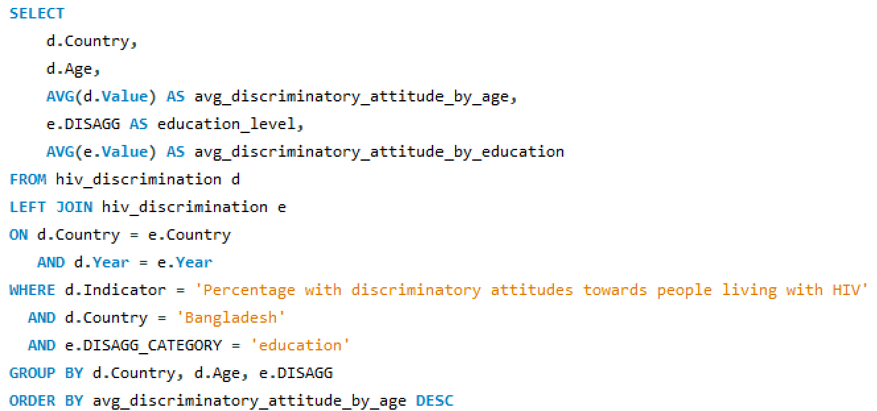
Combined Data Analysis for Bangladesh
Joined the 2 tables to study the number of people living with HIV in Bangladesh who face discrimination by age group and education level.
Discriminatory attitudes decrease slightly as age increases, with the 15-19 group having the highest rates and the 20-24 group showing the lowest.
Across all age groups, individuals with no formal education (pre-primary or none) consistently exhibit the highest discriminatory attitudes. Those with higher secondary+ education have the lowest rates of discriminatory attitudes, demonstrating the strong influence of education in reducing stigma.

Slide 9
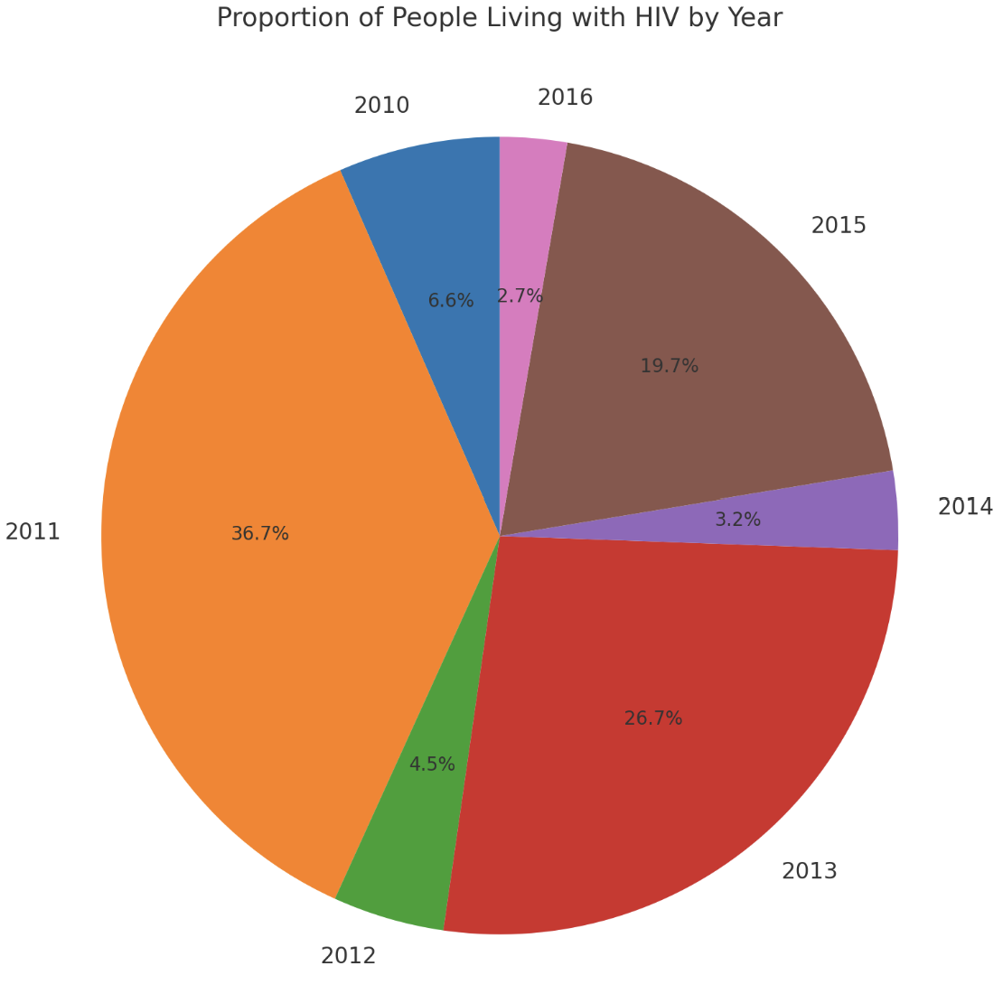
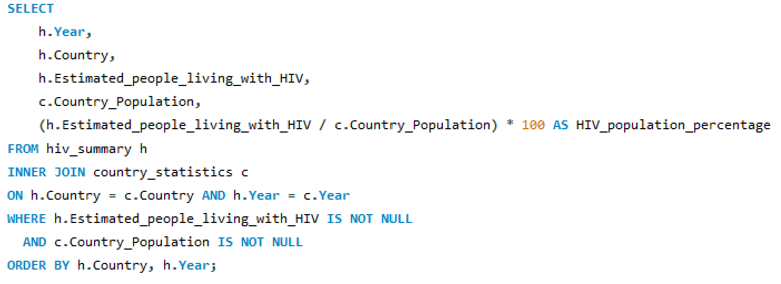
Number of people living with HIV by country population of United States
2011 has the highest proportion of people living with HIV, accounting for 36.7% of the total across the years.
Years like 2016 and 2014 have much smaller proportions, reflecting significantly lower estimates of people living with HIV during those periods.

Slide 10
Analysis & Summary
This projects’ aim was to identify trends over time and highlight the proportion of HIV-affected individuals within the total population, year and gender.
The HIV population shows significant fluctuations over the years, with peaks observed in 2011 (16,200 cases) and 2015 (8,700 cases).
The lowest estimates occurred in 2016 (1,200 cases), indicating a sharp drop compared to previous years.
The total U.S. population steadily increased from 309 million in 2010 to 323 million in 2016.
Despite this growth, the proportion of people living with HIV remained extremely low relative to the total population.
The HIV population percentage compared to the total population ranged from 0.00037% to 0.0052%, showcasing the small scale of the HIV-affected population.
Peaks in 2011 and 2015 may indicate changes in healthcare reporting or increased detection during those periods.
The consistently low HIV population percentage underscores progress in HIV prevention or limited reporting challenges.

Slide 11
HIV Policy Recommendations For The Future HIV Interventions
Improve Data Systems - Standardize HIV data collection and reporting, Use digital tools for real-time monitoring.
Expand Awareness - Launch education campaigns targeting high-risk groups, Include HIV prevention in school curricula.
Boost Healthcare Access - Ensure equitable access to testing and treatment, Fund community health programs for ART and PrEP distribution.
Focus on Prevention - Strengthen mother-to-child transmission prevention programs.
Combat Stigma - Run anti-stigma campaigns in communities, Enforce anti-discrimination laws in workplaces and schools.
Invest in Research - Fund HIV vaccine and treatment research, Study socio-economic factors influencing HIV trends.
Monitor Progress - Establish KPIs to track program success, Use data insights to improve interventions.

Slide 12
Thank You

